Slide 1
HUMAN ACTIVITY RECOGNITION USING DEEP LEARNING
BY : CHIKYALA KAVYA (19N31A0540)
BANDI SHREYA (19N31A0524)
CHALLA RAJESH (20N35A0506)

Slide 2
ABSTRACT
Nowadays, human activity recognition is one of the top examined computer vision issues.The uses of Human Activity Recognition use video perception, human- computer correspondence.
The problem is to predict the activity given a snapshot of sensor data, typically data from one or a small number of sensor types. Generally, this problem is framed as a univariate or multivariate time series classification task.
It is a challenging problem as there are no obvious or direct ways to relate the recorded sensor data to specific human activities and each subject may perform an activity with significant variation, resulting in variations in the recorded sensor data.The intent is to record sensor data and corresponding activities for specific subjects, fit a model from this data, and generalize the model to classify the activity of new unseen subjects from their sensor data.

Slide 3
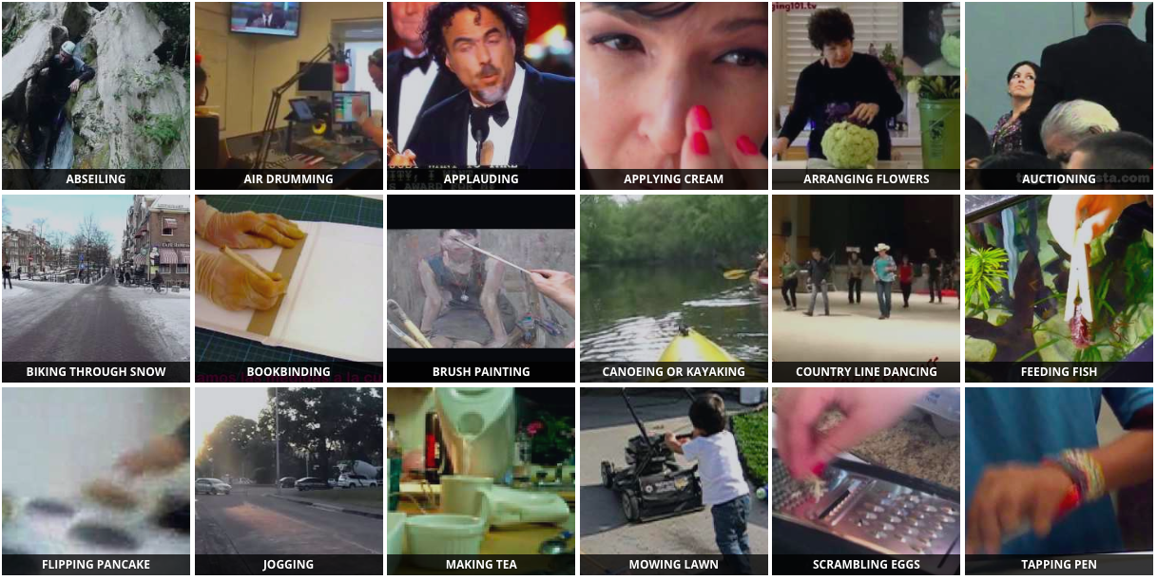
INTRODUCTION
Nowadays, human activity recognition is one of the top examined computer vision issues. The uses of Human Activity Recognition use video perception, human- computer correspondence

Slide 4
LITERATURE SURVEY
The developed algorithm for the human action recognition system, which uses the two-dimensional discrete cosine transform(2D-DCT) for image compression and the self organizing map(SOM) neural network for recognition purpose, is simulated in MATLAB. By using 2D-DCT we extract image vectors and these vectors become the input to neural network classifier, which uses self organizing map algorithm to recognize elementary actions from the images (trained). SOM has good feature extracting property due to its topological ordering. Using an image database of 30 action images, containing six subjects and each subject having five images with different body postures reflects that the action recognition.

Slide 5
REQUIREMENTS
HARDWARE REQUIREMENTS:
Processor : Intel Based Systems
Hard Disk : 40 GB
RAM : 4 GB(minimum)
SOFTWARE REQUIREMENTS:
Operating System : Windows 10
Technology : Python
Software : Anaconda (pycharm)

Slide 6
DOMAIN
DEEP LEARNING-
Deep learning is focused on improving that process of having machines learn new things. With rule-based AI and ML, a data scientist determines the rules and data set features to include in models, which drives how those models operate. With deep learning, the data scientist feeds raw data into an algorithm. The system then analyzes that data, without specific rules or features preprogrammed into it. Once the system makes its predictions, they are checked against a separate set of data for accuracy. The level of accuracy of these predictions—or lack thereof—then informs the next set of predictions the system makes.

Slide 7
DOMAIN
The “deep" in deep learning refers to the many layers the neural network accumulates over time, with performance improving as the network gets deeper. Each level of the network processes its input data in a specific way, which then informs the next layer. So the output from one layer becomes the input for the next.

Slide 8
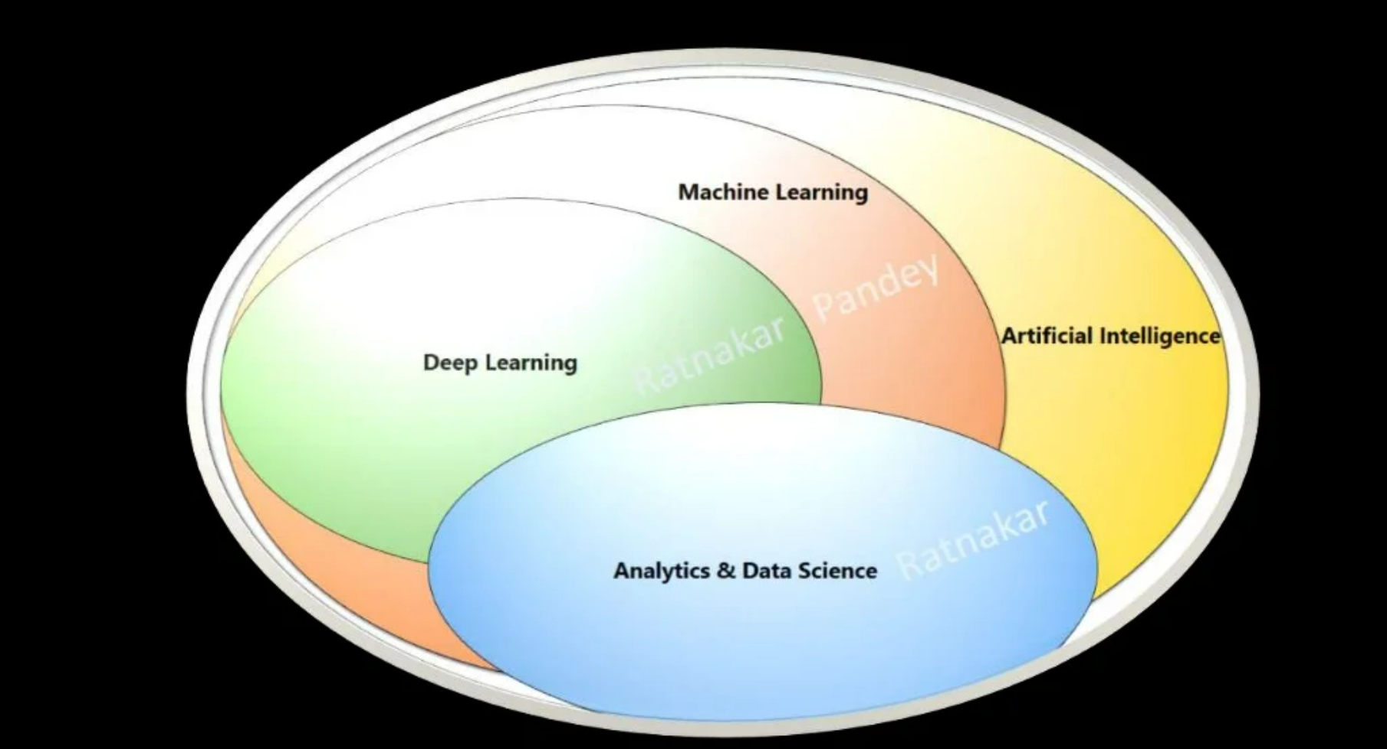

Slide 9
EXISTING SYSTEM
In existing system, several approaches were proposed to improve the performance of trajectories in action recognition with different ways.
This approach used the relationships of these groups to capture spatio-temperal structure of an action, thus can provide a more informative representation.
Disadvantages :
It has difficulties in dealing with actions on the duration variations and has low quality.

Slide 10
PROPOSED SYSTEM
In proposed system, the system uses Binary Motion Image to perform human activity recognition.
The Binary Motion Image is created by combining the image sequences into a single.
As a last phase we are detecting the action also as well as sending an alert message to the respective mail id.
Advantages : High Speed.
High Quality.
It is more effective.

Slide 11
Modules Description
Import python Libraries
-Collections : provides different types of containers
-CV2 : Image/Video feed
-Imultis : Image Processing functions
-Numpy : working with Arrays
2. Load the Dataset
-Giving path of pretrained model and its classes
-Read classes and store them in a list

Slide 12
Modules Description
3. Preprocess data
-Capture video frame either through video/webcam
-Read a frame from video stream
4. Tr3aining Dataset(Train the model)
-Annotate the data
5.Testing Dataset
-Test the model
-Final model

Slide 13
Modules Description
6. Predict the Output
-Draw Predicted activity on frame
-Display frame to our screen.

Slide 14
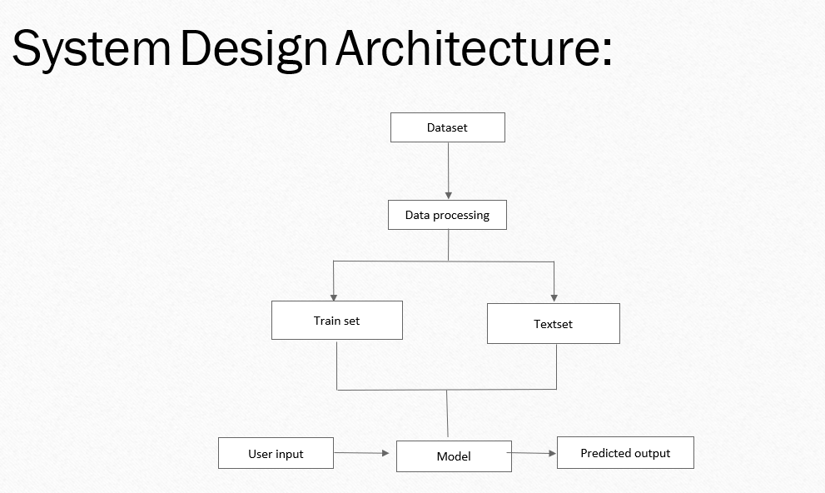

Slide 15
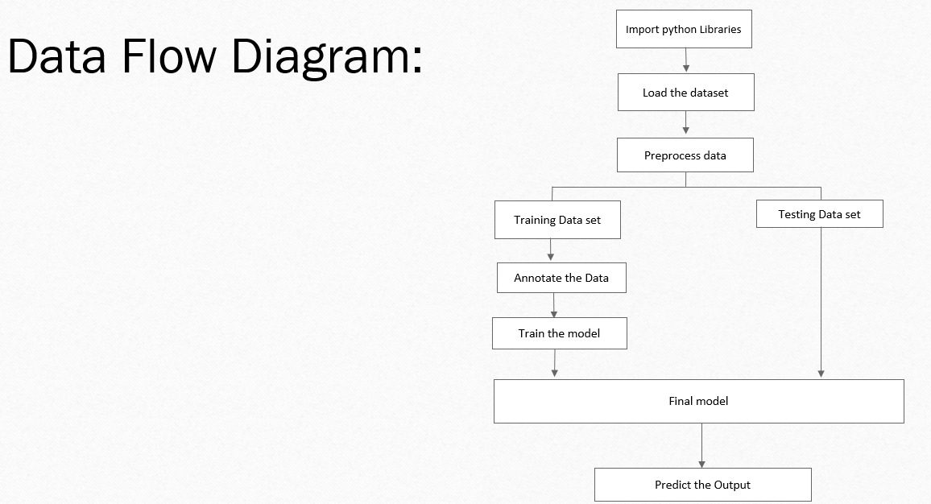

Slide 16
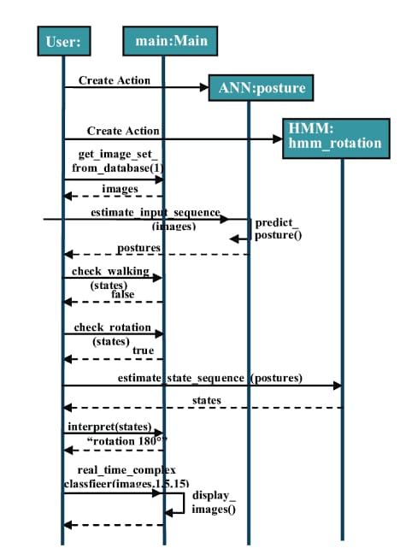

Slide 17
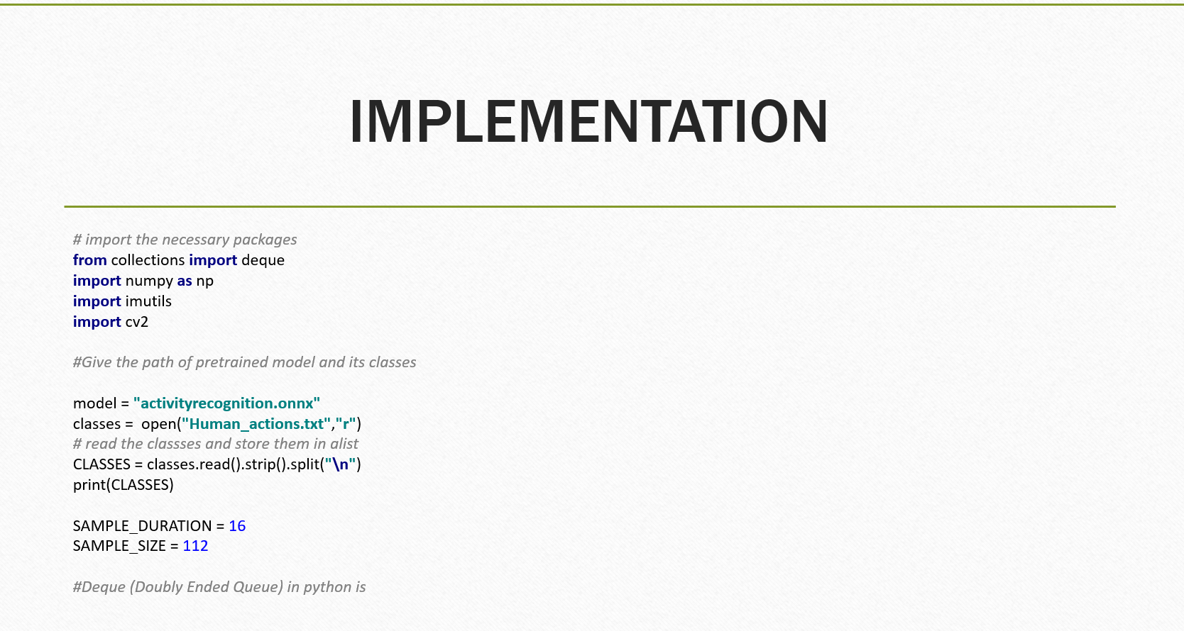

Slide 18
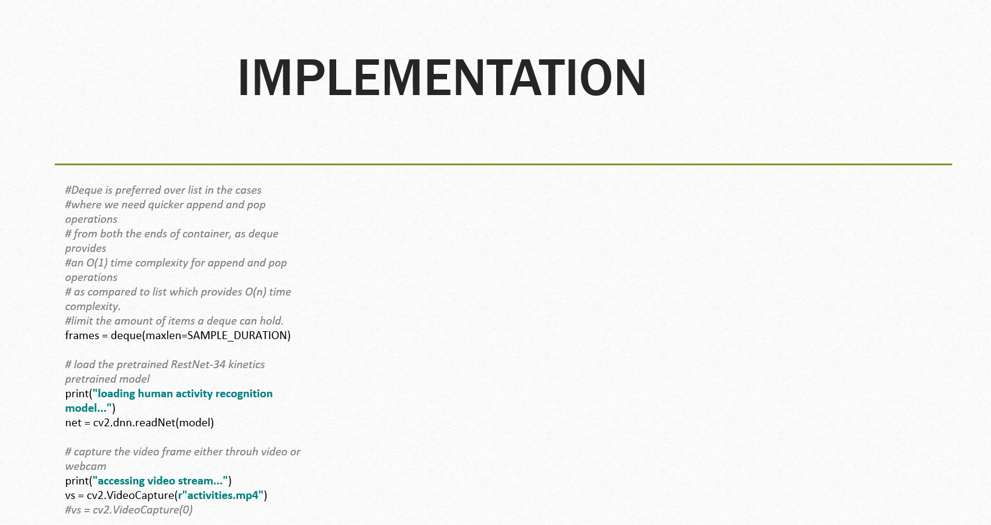

Slide 19
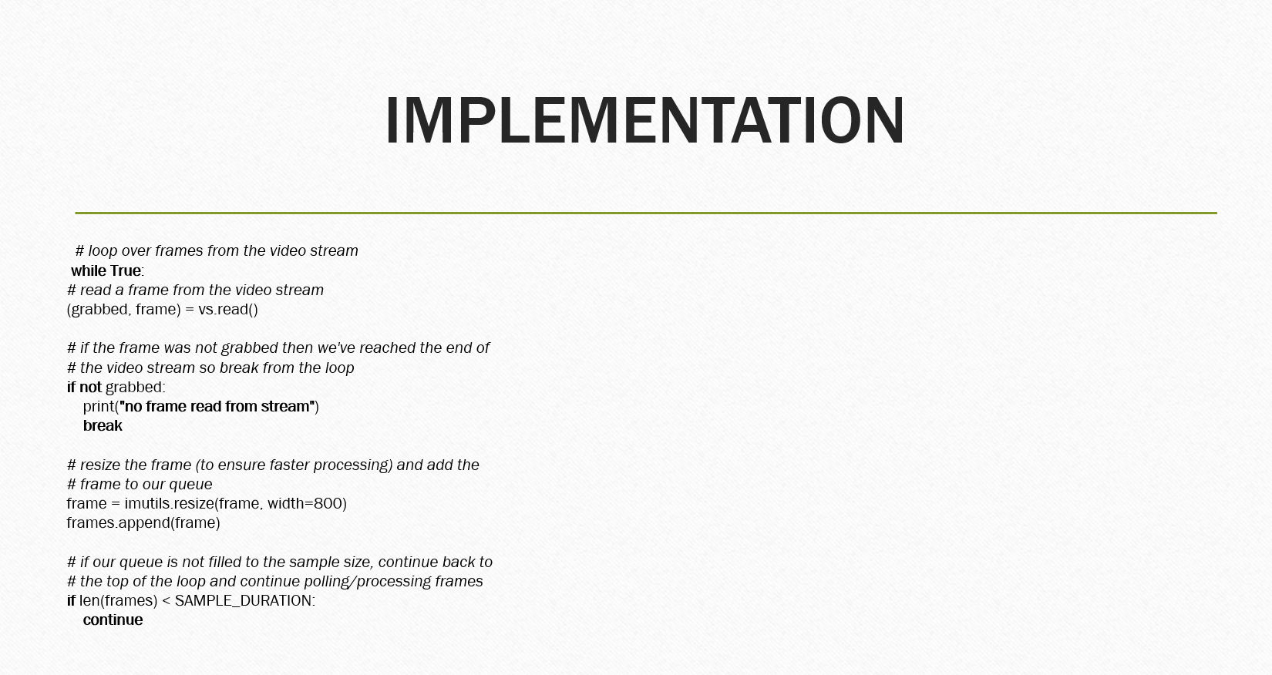

Slide 20
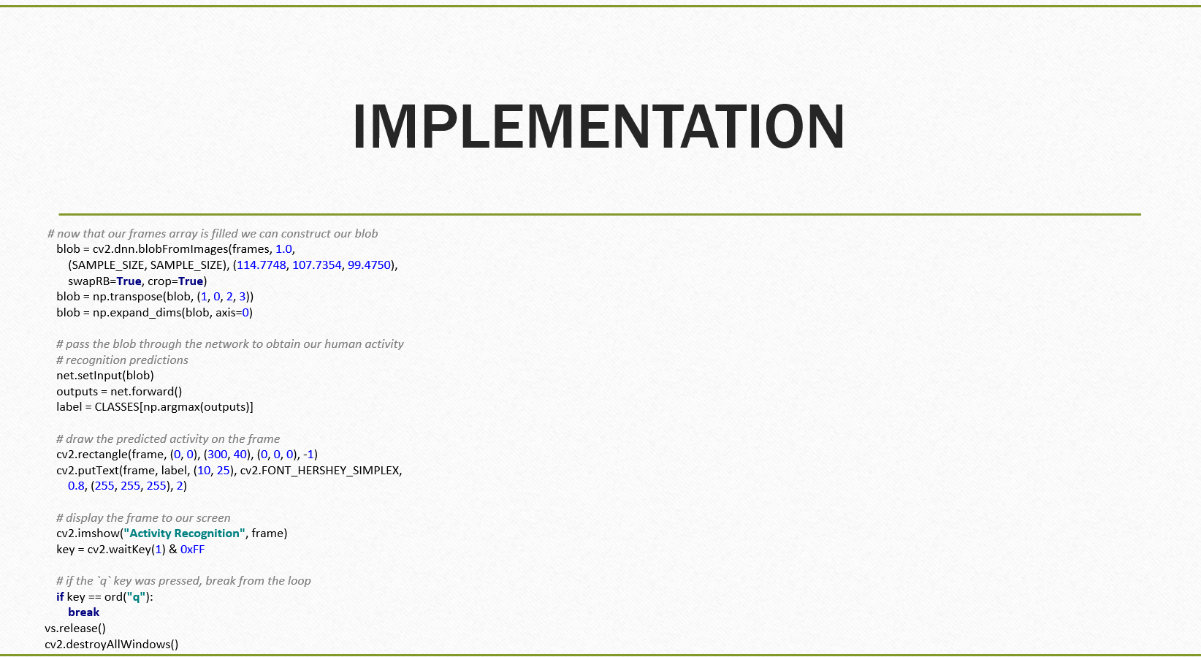

Slide 21
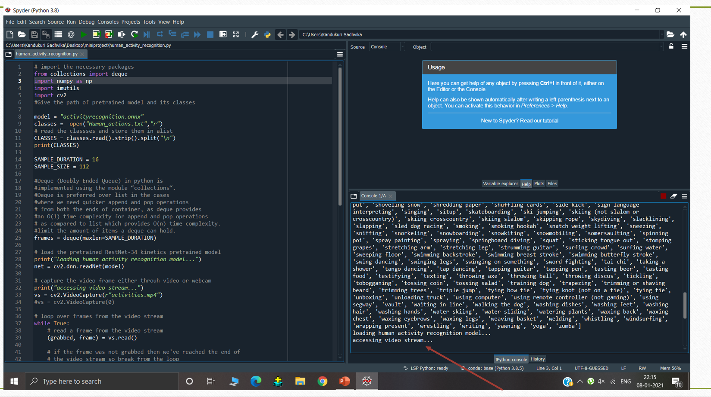

Slide 22
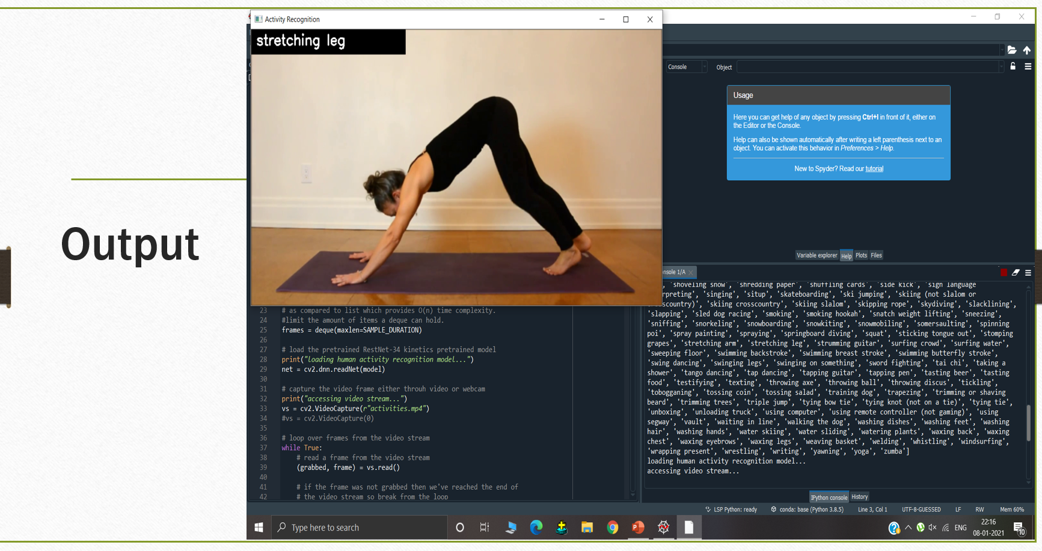

Slide 23
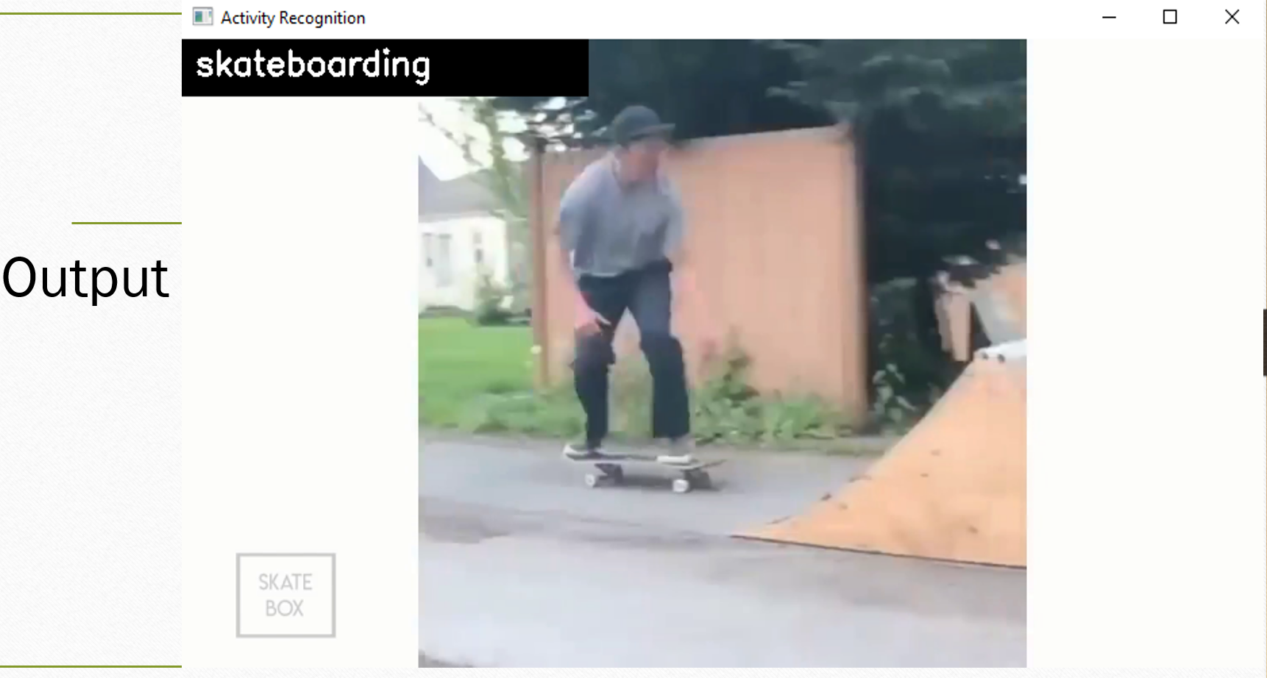

Slide 24
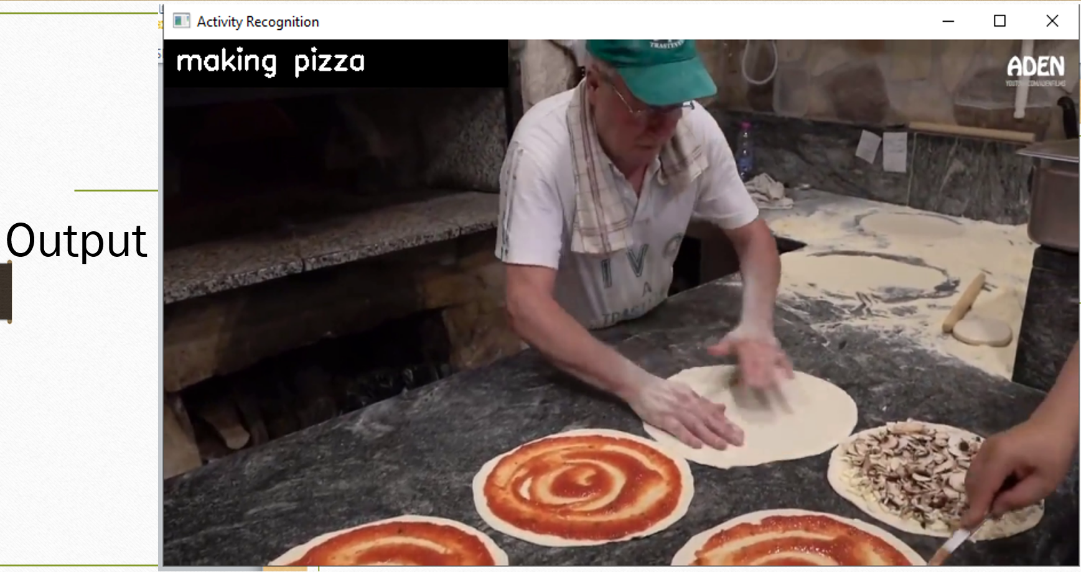

Slide 25
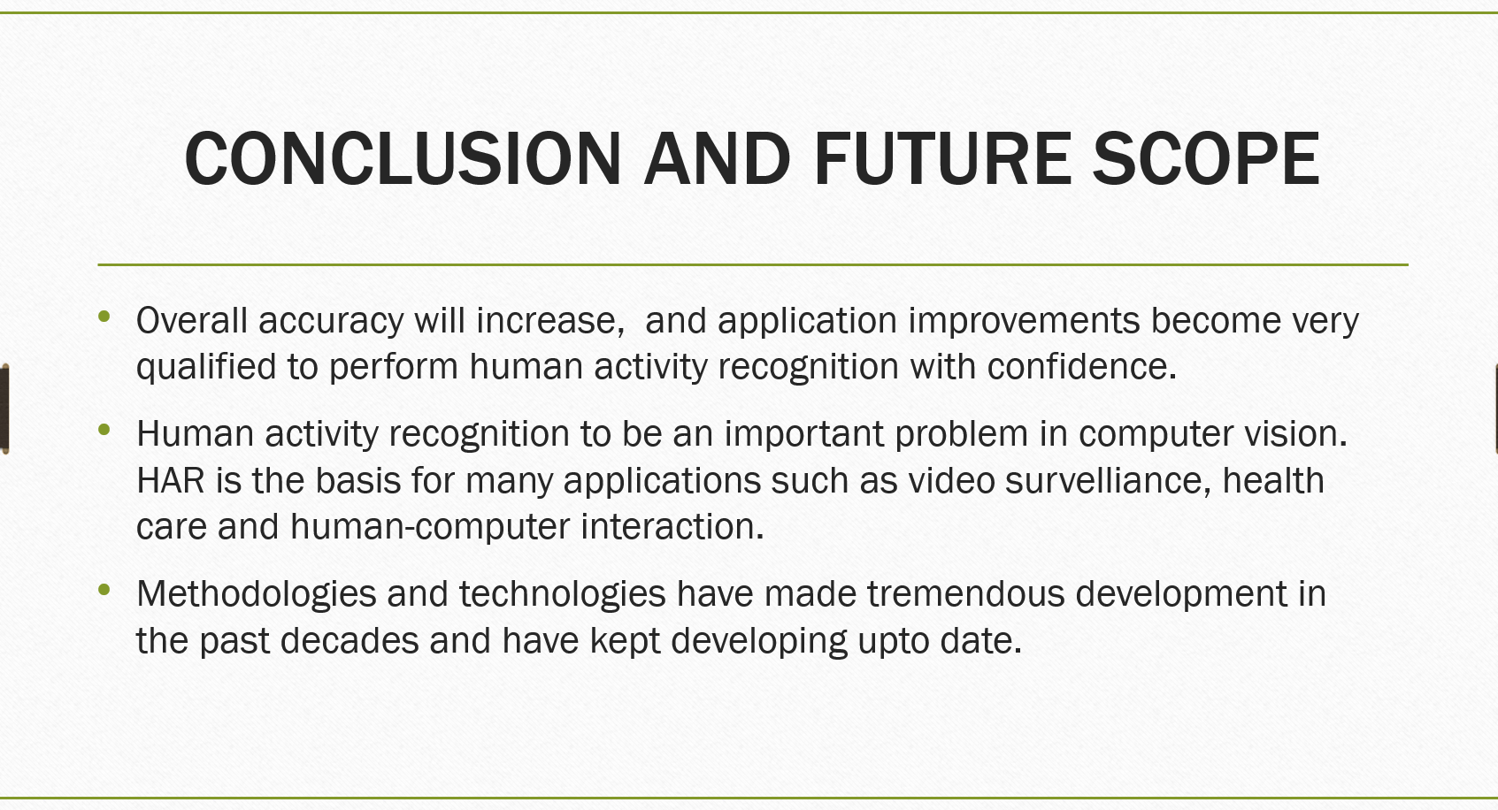

Slide 26


